Slide 1
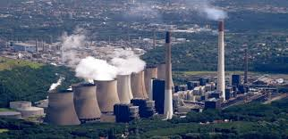
Power Plants

Slide 2
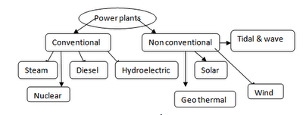
POWER PLANTS
A power plant is a facility where electrical power is generated. A power plant is also referred as power station or power house or a generating station.
Power plants can be classified as shown below:

Slide 3
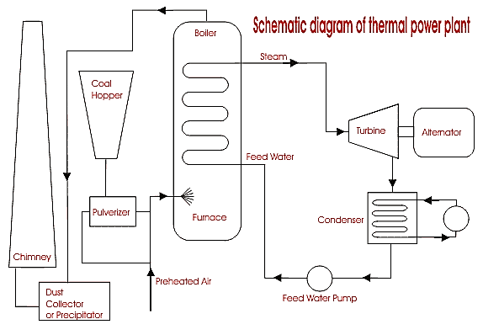
Thermal Power Plant
In thermal power stations, mechanical power is produced by a steam turbine that transforms thermal energy of steam obtained from combustion of fuel into rotational energy.

Slide 4
Thermal Power Plant
Steam boiler produces steam at high pressure and temperature that is passed through the turbine.
High pressure steam is expanded in the turbine to generate power output.
The expanded steam is then passed through the condensor, where, steam is condensed to water before it is pumped back to boiler for heat absorption.
The combustion products/burnt gases are exhausted to atmosphere through chimneys/ stacks.

Slide 5
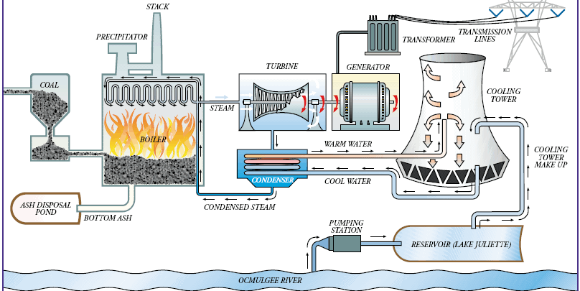
Thermal Power Plant- A pictorial View

Slide 6
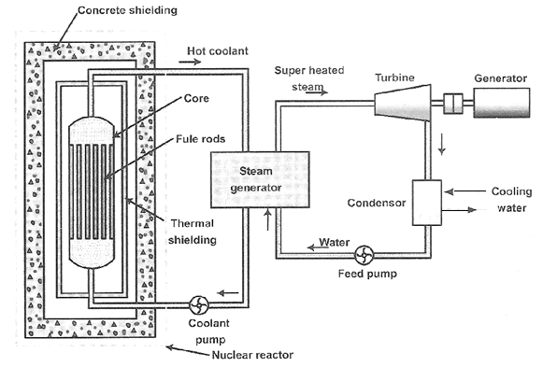
Nuclear Power Plant
A nuclear power plant is a thermal power station in which the heat source is a nuclear reactor.
As is typical in all conventional thermal power stations the heat is used to generate steam which drives a steam turbine connected to a generator which produces electricity.
The conversion to electrical energy takes place indirectly, as in conventional thermal power plants. The heat is produced by fission reaction in a nuclear reactor.

Slide 7
Nuclear Power Plant
The core of the reactor contains the nuclear fuel and generates all the heat. It contains low-enriched uranium (<5% U-235), control systems, and structural materials. The core can contain hundreds or thousands of individual fuel pins.
The heat generated in the reactor due to nuclear fission reaction is taken up by the coolant (Usually Heavy water, liquid sodium or helium).
The hot coolant then leaves the reactor and flows through the steam generator.
In the steam generator the hot coolant transfers its heat to the feed water which gets converted into steam.

Slide 8
Nuclear Power Plant
The steam produced is passed through the turbine which is coupled to the generator and thus power is produced.
The exhaust steam from the turbine is condensed in the condenser.
The condensate then flows to the steam generator through the feed pump.
The containment is the structure that separates the reactor from the environment. These are usually dome-shaped made of high-density steel-reinforced concrete.

Slide 9
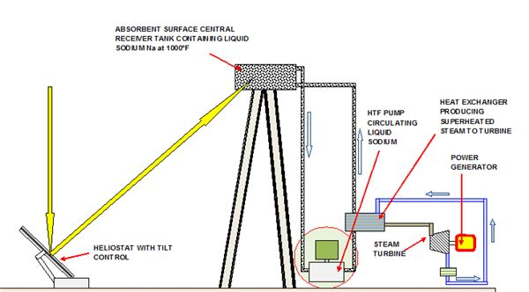
Solar Thermal Power Plant

Slide 10
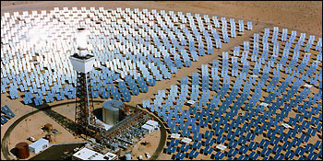
Solar Thermal Power Plant
Solar energy can be turned into electricity either directly in solar cells, or in a concentrating solar thermal power plant by focusing the light to run a heat engine.
A solar photovoltaic power plant converts sunlight into direct current electricity using the photoelectric effect. This type of plant does not use rotating machines for energy conversion.
Solar thermal power plants are another type of solar power plant. They use either parabolic troughs or heliostats to direct sunlight onto a pipe containing a heat transfer fluid(HTF), such as liquid sodium.

Slide 11
Solar Thermal Power Plant
The central tower type of solar thermal power plant uses hundreds or thousands of mirrors to direct sunlight onto a receiver on top of a tower.
The central tower receiver absorbs the solar radiation reflected by the heliostats and transfers this heat energy to liquid sodium. Hot liquid sodium is then passed to the steam generator where the water flowing absorbs heat from liquid sodium and gets converted into high temperature steam.
This steam is passed through the steam turbine to generate electricity much like a steam power plant.
The liquid sodium is pumped back to the central receiver to absorb more heat.

Slide 12
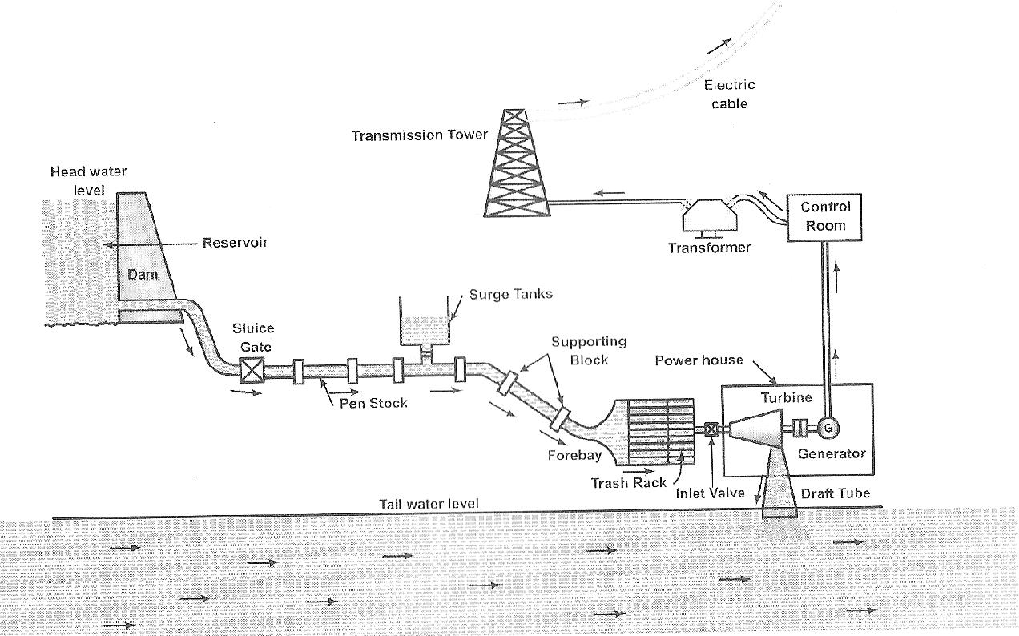
Hydel Power Plant
A hydel power plant utilizes the potential energy of water stored in a dam built across the river. The potential energy of the water is first converted into kinetic energy to run the water turbine to which the electric generator is coupled. The mechanical energy available at the shaft of the turbine is converted into electrical energy by means of the generator.

